Slide 1
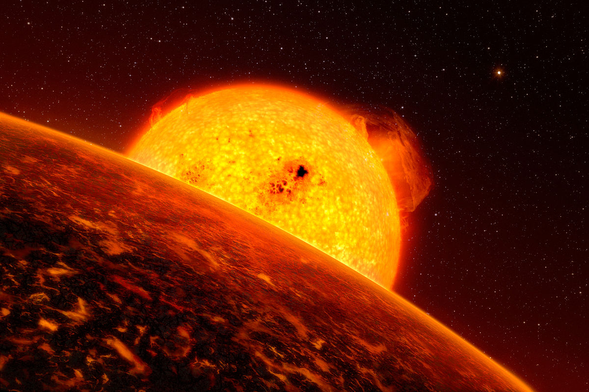
SEMANTIC WEB TECHNOLOGIES
Extract rules from dbpedia
to predict numerical properties
Sergio Enrico Coppolecchia
684188
Quest foto di Autore sconosciuto è concesso in licenza da CC BY-SA

Slide 2
The Problem
Data extracted from wikipedia are frequently incomplete.
Consequently, on dbpedia there are many missing data.

Slide 3

The solution
Use machine learning on present features to construct a regression tree that predict some parameter
Convert the regression tree produced into Jena rules in order to prodict the missing values
Questa foto di Autore sconosciuto è concesso in licenza da CC BY-NC-ND

Slide 4
DATA RETRIEVING

Slide 5

QUERYING DBPEDIA
DBpedia is a crowd-sourced community effort to extract structured content from the information created in various Wikimedia projects.
Questa foto di Autore sconosciuto è concesso in licenza da CC BY-SA

Slide 6
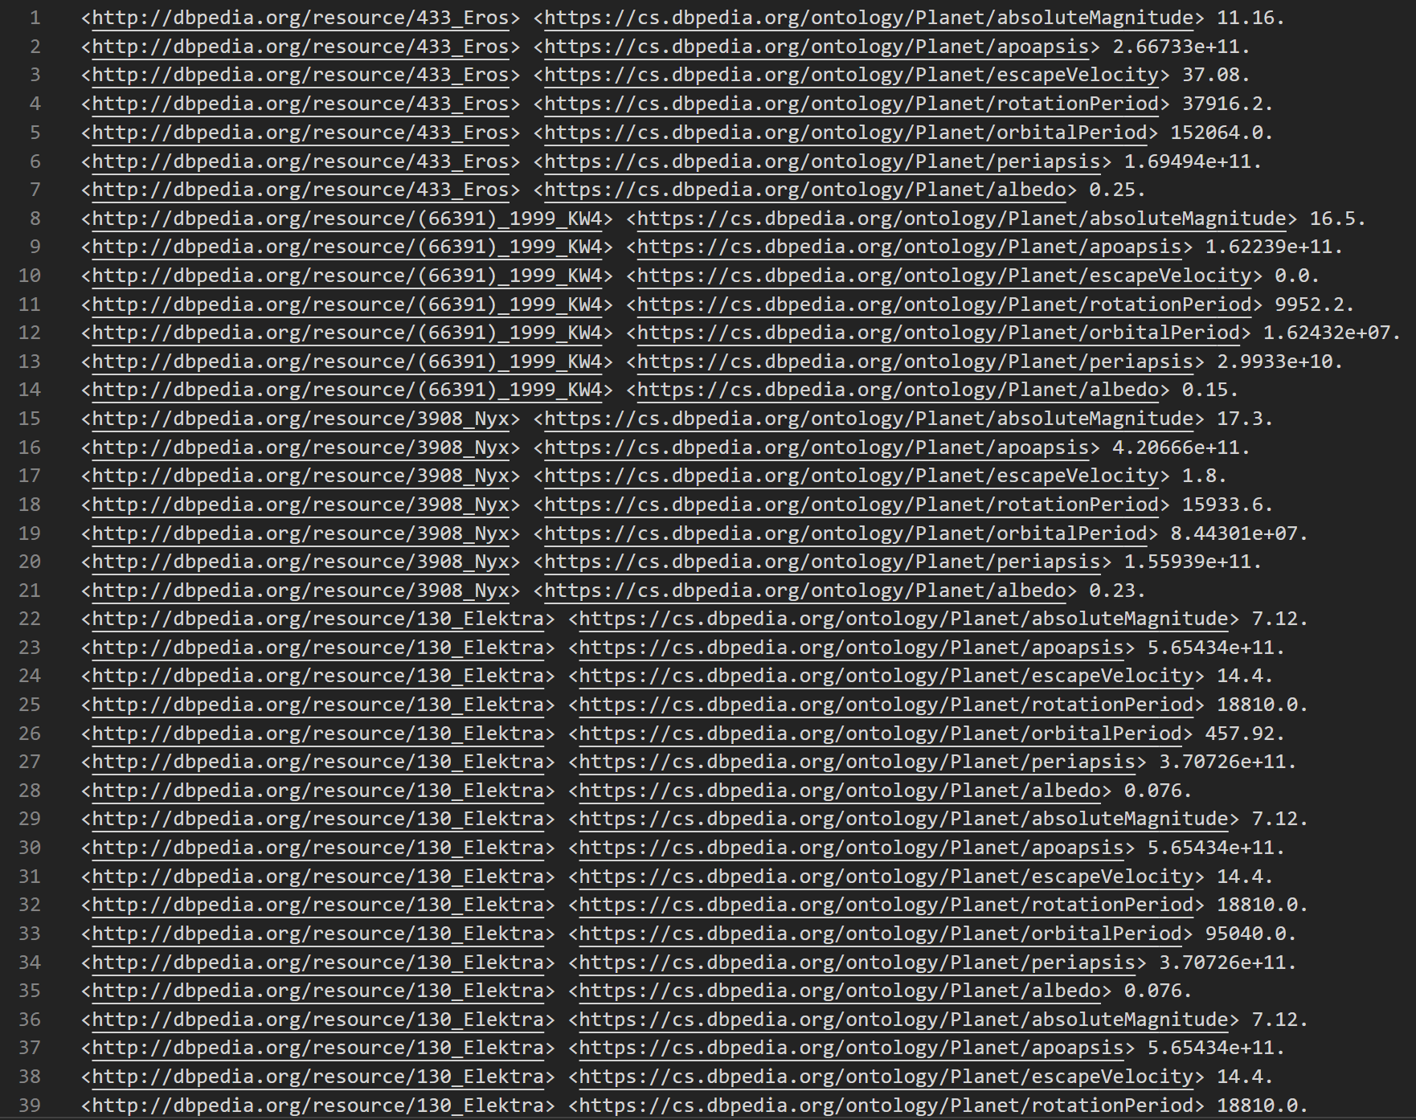
QUERYING DBPEDIA
Querying dbpedia by a SPARQL end-point we obtain the following triples
Notice that objects on the triples are numeric litteral

Slide 7
SCIKIT-LEARN REGRESSION TREE

Slide 8

PREPROCCESSING
in order to let scikit-learn processable data, triples are transformed in a matrix
The triples that contains features in X matrix
The triples that contains the target in y vector

Slide 9
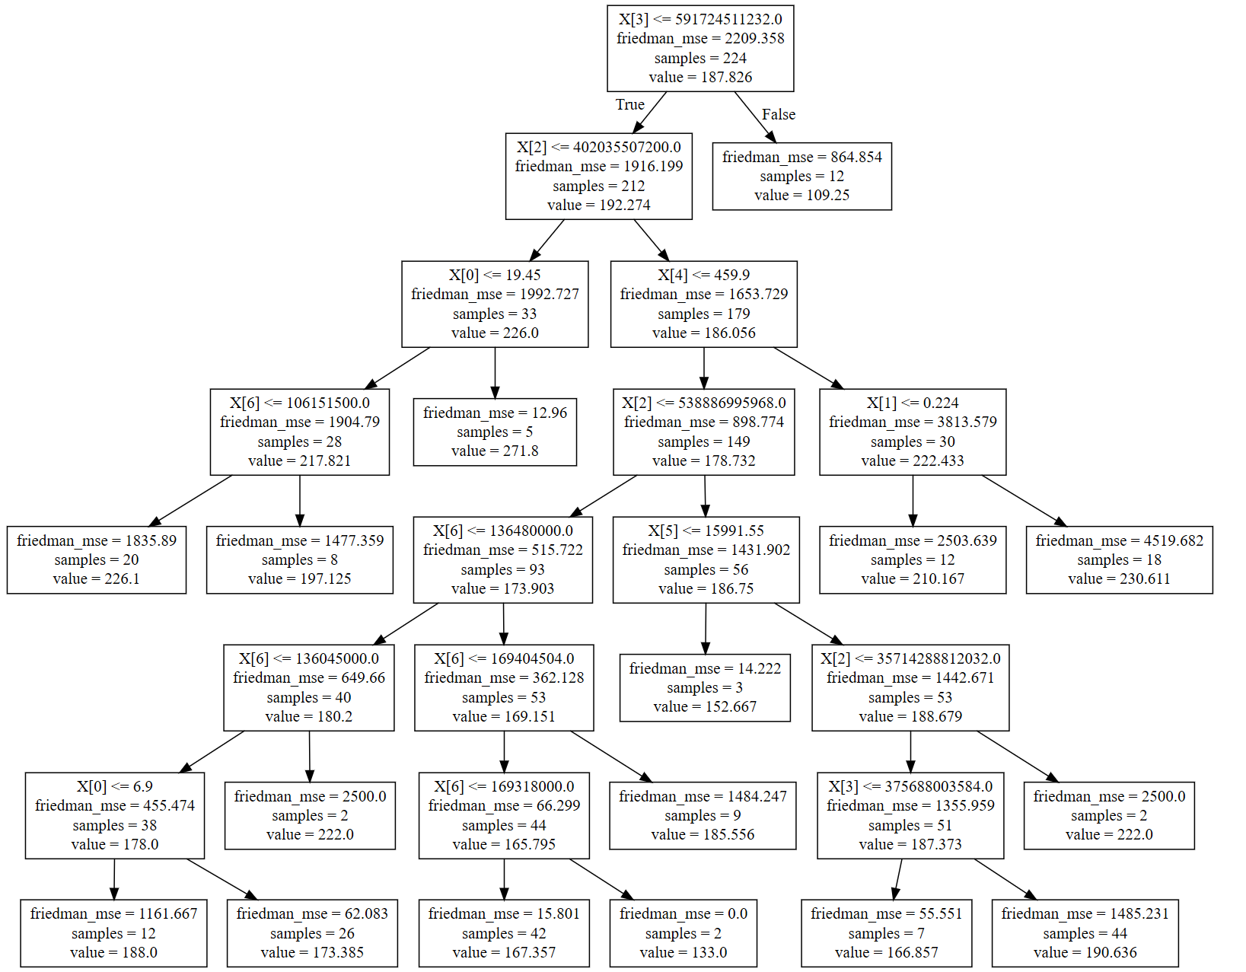
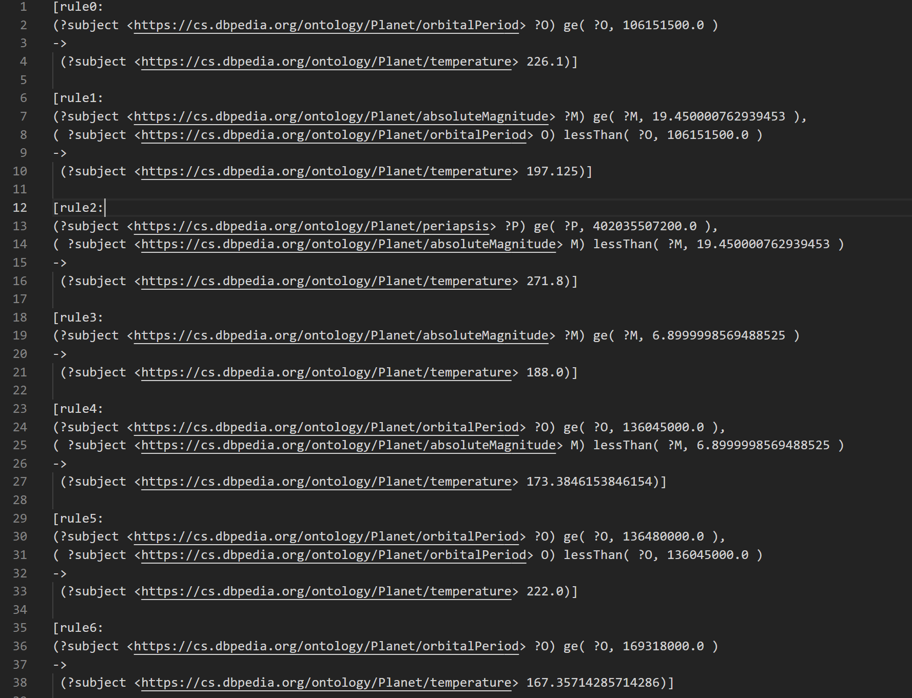
FROM REGRESSION TREE TO JENA RULES
Using sklearn library a regression tree will be produced
Then the regression tree is converted in Jena rules

Slide 10

USING JENA RULES

Slide 11
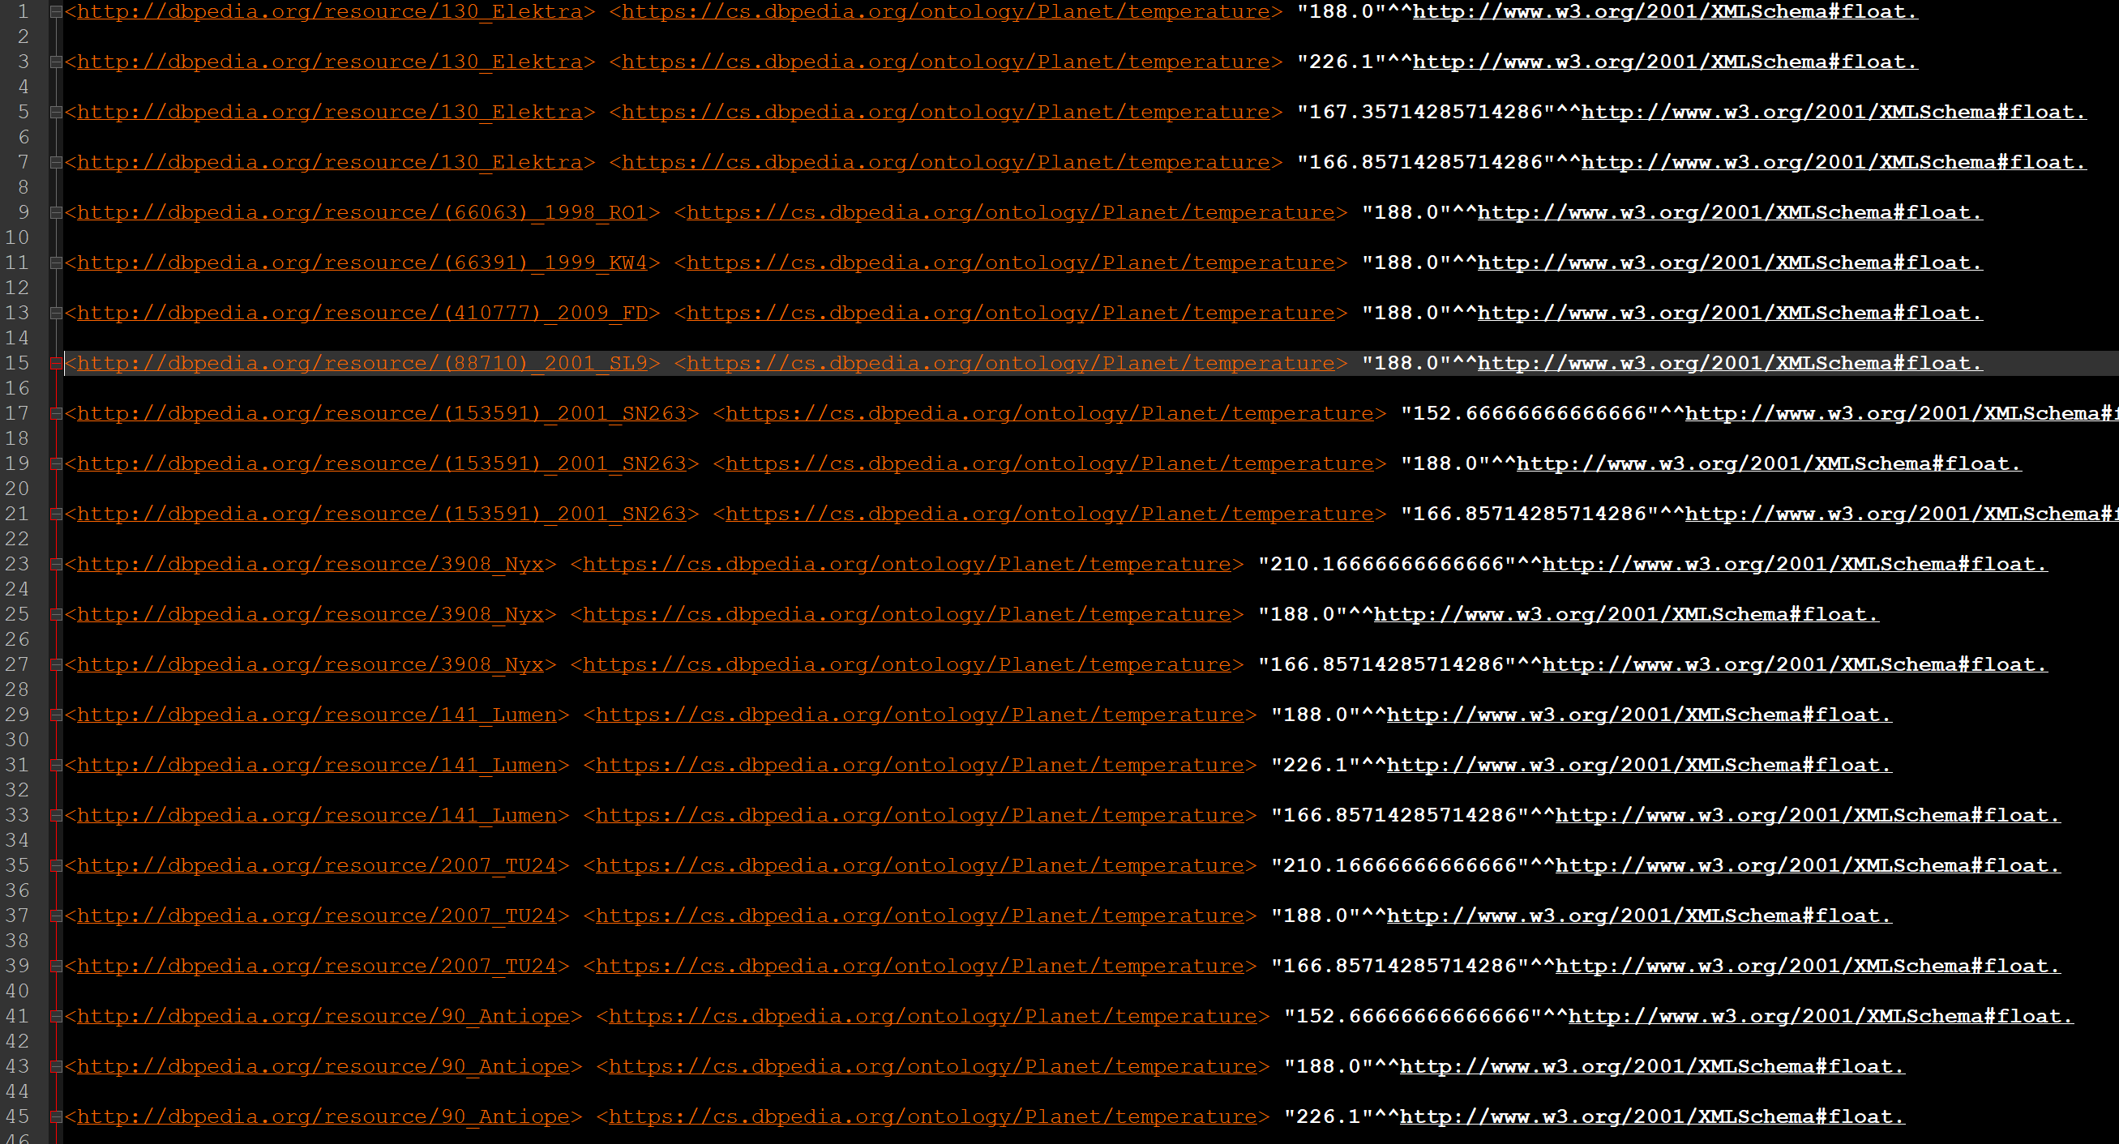
JENA RULES
Applying jena rules to missing target object, we obtain a complete knowledge base.

Slide 12
BUT HOW MUCH ACCURATE IS THE MODEL?

Slide 13
DATASETS
NAME | FEATURES | TARGET | RANGE | NUM OF SAMPLES
PLANETS | 7 | Temperature | [123.0 - 301.0] C° | 224
PEOPLE | 2 | Weight | [184 - 42] kg | 255
HOTELS | 2 | Number of rooms | [1511 - 1] | 10000
The datasets have the following characteristics

Slide 14
FEATURES
PLANETS | PEOPLE | HOTELS
absoluteMagnitude (m) | Year (of birth) | floorsCount
Apoapsis (AU) | Height (g) | numberOfSuites
escapeVelocity (km/s)
rotationPeriod (days)
orbitalPeriod (days)
Periapsis (AU)
albedo

Slide 15
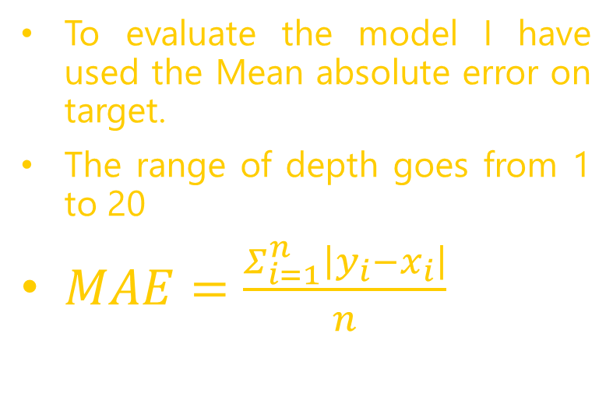
PLANETS
To evaluate the model I have used the Mean absolute error on target.
The range of depth goes from 1 to 20
$MAE=\frac{Σ_{ⅈ=1}^{n}\left|y_{i}−x_{i}\right|}{n}$

Slide 16
PEOPLE
Here we have the better results
The range of values is [184, 42] kg
the best MAE is just of 9,2 kg

Slide 17
HOTELS
But considering the range of values (i.e. [1511, 1] rooms) the lowest error is of 200 rooms

Slide 18

CONCLUSIONS
In some case missing data can be approximated with this method
The model (in case of Peoples) works well because there are a lot of samples

Slide 19

FUTURE WORKS
Use other machine learning methods that works well with incomplete data to improve the performance
Increase the number of samples
Questa foto di Autore sconosciuto è concesso in licenza da CC BY

Slide 20

THANKS FOR YOUR ATTENTION
Questa foto di Autore sconosciuto è concesso in licenza da CC BY-NC-ND

